Slide 1
Image Classification
Submitted by
Tushar Kumar Patel

Slide 2
Project analysis slide 2
Project Analysis
Inrtoduction
Visualization
Image classification
Dataset and Features
Model
Processing
Conclusion

Slide 3
Introduction
Initially the collection of the data of Sarees, Jeans and Trouser has been scrapped using selenium.
In today’s modern world everyone is fulfilling their daily needs from E-commerce websites. One of them is their clothing needs which is very important in the world of faishon and nobody wants to be left behind. So, e-commerce websites have added a new feature to their website i.e. The classification feature that will classify various product. Now they want to predict the new images that will classify the image in different section that will allow to search the images of different segment. So, we have to build an application which can predict the image and put them in the category to which they belong.

Slide 4
CONCEPTUAL BACKGROUND OF THE DOMAIN PROBLEM
Images are one of the major sources of data in the field of data science and AI.
This field is making appropriate use of information that can be gathered through images by examining its features and details.
The idea behind this project is to build a deep learning-based Image Classification model on images that will be scraped from e-commerce portal. This is done to make the model more and more robust.

Slide 5
PROBLEM STATEMENT
We have to scrape images from e-commerce portal, Amazon.IN The clothing categories used for scraping will be:
  Sarees (women)
  Trousers (men)
  Jeans (men)
After the data collection and preparation is done, you need to build an image classification model that will classify between these 3 categories mentioned above.

Slide 6
ANALYTICAL PROBLEM FRAMING
Data Collection Phase:
We have collected/scraped data from amazon for the three categories: Sarees, Jeans and Trousers.
In total there are 343 rows for each of the items

Slide 7
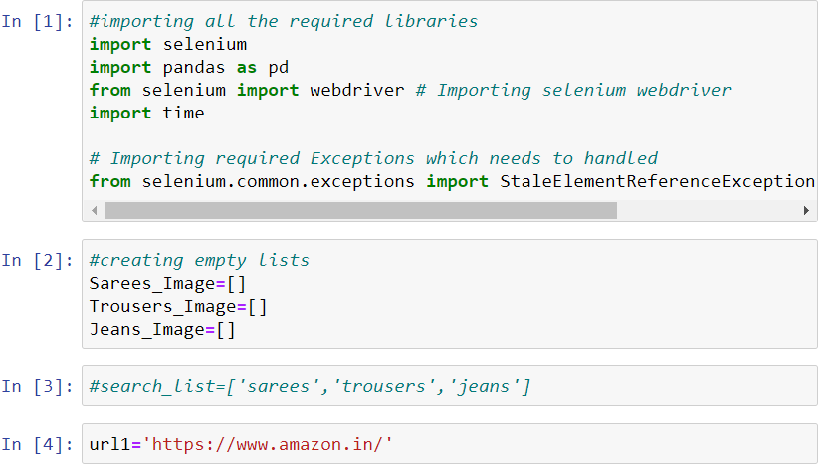
ANALYTICAL PROBLEM FRAMING

Slide 8
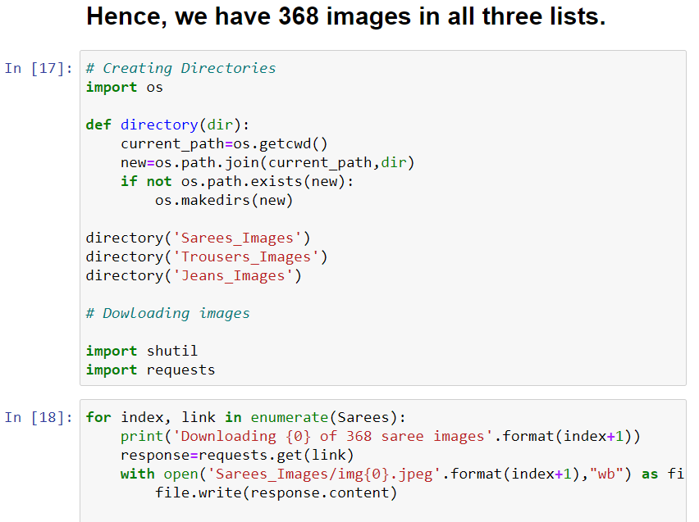
Hence we have 300 images in each section.

Slide 9
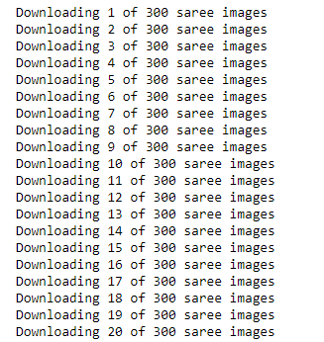
Next we created directories to store images of each clothing item scraped above. Further we will be downloading images to required folders/directories along with download status message.

Slide 10
MODEL/S DEVELOPMENT AND EVALUATION
After collecting the data we next do training of the data. For that firstly, we created a main folder called “Clothes” in current working directory inside which I further created two folders called “Train” and “Test”.
In Train folder we have kept 300 images from each clothing category and remaining 25 images we have kept in Test folder for each category. Hence, we got 825 images for training and 75 for testing.

Slide 11
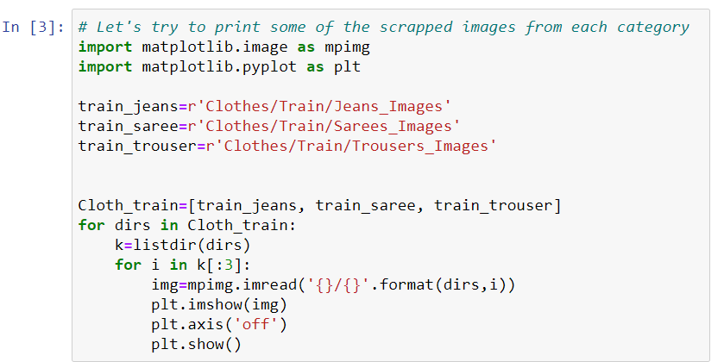

Slide 12
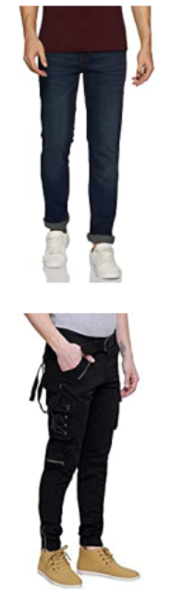
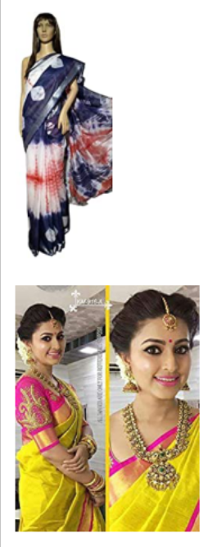
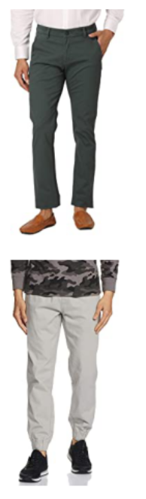
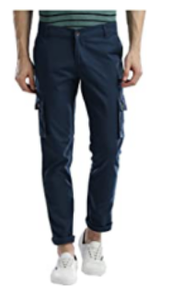

Slide 13
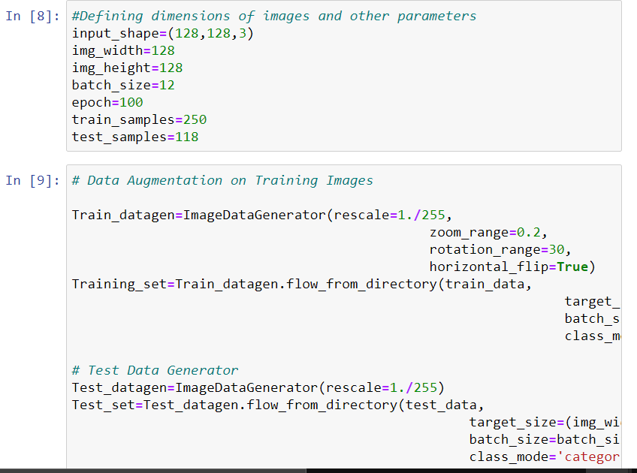
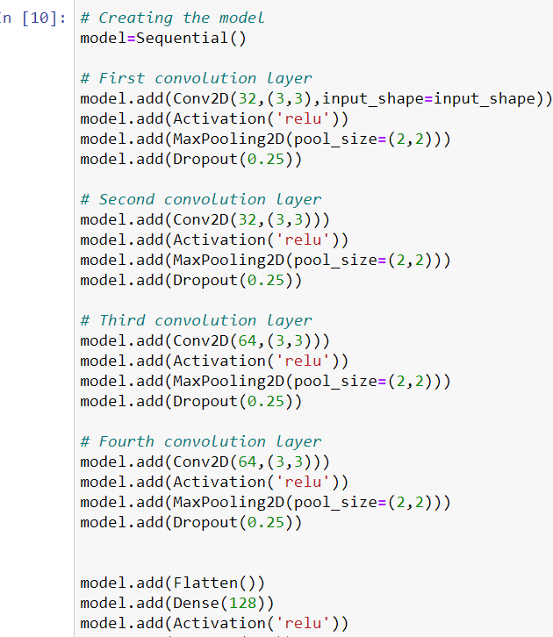
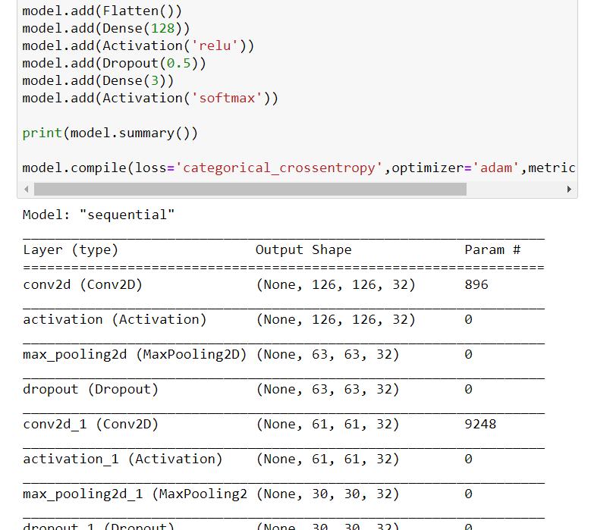

Slide 14
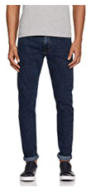
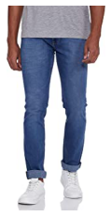

Slide 15
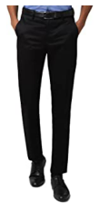
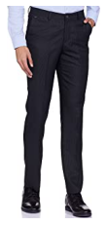

Slide 16
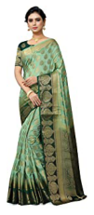
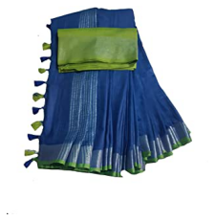

Slide 17
CONCLUSION
Our model is working well and gave accuracy of 87.5%.
It was able to classify the three clothing items distinctly.
Since in all three categories there were some extra/unnecessary items other than the main items hence, it could have been removed and we could have got better result. Moreover, training data could have been increased.

Slide 18
Thank You

